Slide 1

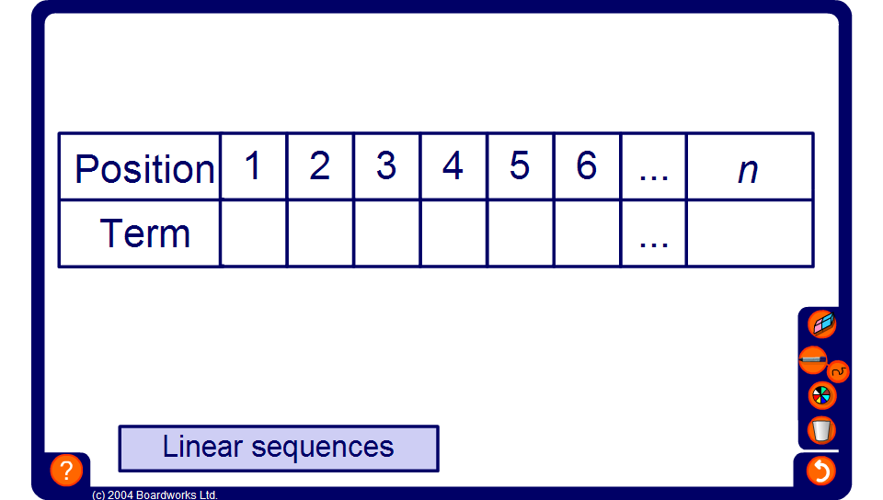


Sequences from position-to-term rules
Notes:
Start by revealing the value of the n^{th} term and ask pupils to find the value of each term using substitution. You may choose from linear and quadratic sequences.
Alternatively, give pupils the six terms and ask then to find an expression for the n^{th} term.

